Slide 1

UNIVERSITY INSTITUTE OF ENGINEERING
COMPUTER SCIENCE ENGINEERING
Master of Engineering
ADVANCED DATA STRUCTURES
&
ALGORITHMS
(23CSH-622)
INTRODUCTION
DISCOVER . LEARN . EMPOWER

Slide 2

ADVANCED DATA STRUCTURES
&
ALGORITHMS
(23CSH-622)
By : Dr. Ranjit Singh (E10947)
www. cuchd.in Campus : Gharaun, Mohali

Slide 3
TREES
Course Outcome
Will be covered in this lecture
CO Number | Title | Level
CO1 | To understand role of algorithms in science and practice of computing.. | Remember
CO2 | To gain familiarization with different algorithm design techniques. | Understand
CO3 | To apply different algorithm design techniques for solving engineering and related problems and study their performance. | Analysis and application

Slide 4
Lecture Objectives
To impart the basic concepts of tree data structures and algorithms.
To understand about writing algorithms and step by step approach in solving problems with the help of trees.
To Understand basic concepts about trees.
Lecture Outcome:-Students will
1. Able to compare between different types of tree data structures and use an appropriate data structure for a design.
2. Identify the strengths and weaknesses of different tree data structures.

Slide 5
Topics to be covered
Introduction to Trees Data structure
Need for Trees
Basic Terminology
Representation of Trees
Binary Trees
Tree Traversals
Threaded Binary Trees

Slide 6
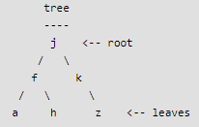
Trees
Unlike Arrays, Linked Lists, Stack and queues, which are linear data structures, trees are hierarchical data structures.
Tree Vocabulary: The topmost node is called root of the tree. The elements that are directly under an element are called its children. The element directly above something is called its parent. For example, a is a child of f and f is the parent of a. Finally, elements with no children are called leaves.

Slide 7
Why Trees?
1. One reason to use trees might be because you want to store information that naturally forms a hierarchy. For example, the file system on a computer.(directory structure)
2. Trees (with some ordering e.g., BST) provide moderate access/search (quicker than Linked List and slower than arrays).

Slide 8
Introduction
Definition : A tree is a finite set of one or more nodes such that
There is a specially designated node called root.
-Tree can be defined as collection of nodes to simulate hierarchical structure .

Slide 9
Some Terminology
node: the item of information plus the branches to each node.
degree: the number of subtrees of a node
degree of a tree: the maximum of the degree of the nodes in the tree.
terminal nodes (or leaf): nodes that have degree zero
Non terminal nodes: nodes that don’t belong to terminal nodes.
children: the roots of the subtrees of a node X are the children of X
parent: X is the parent of its children.

Slide 10
Some Terminology (cont’d)
Siblings: children of the same parent are said to be siblings.
Ancestors of a node: all the nodes along the path from the root to that node.
The level of a node: defined by letting the root be at level one. If a node is at level l, then it children are at level l+1.
Height (or depth): the maximum level of any node in the tree

Slide 11
Binary Trees
Binary trees are characterized by the fact that any node can have at most two branches
Definition
A binary tree is a finite set of nodes that is either empty or consists of a root and two disjoint binary trees called the left subtree and the right subtree

Slide 12
Types of Binary Trees
Rooted Binary Tree: It has a root node. Each node has at most 2 children.
Full Binary Tree/Strict: A binary tree in which every node has either 0 or 2 children is called as a Full binary tree.
Complete Binary Tree/Perfect: Every internal node has exactly 2 children. All the leaf nodes are at the same level.
Skewed Binary Tree: All the nodes except one node has one and only one child. The remaining node has no child.

Slide 13
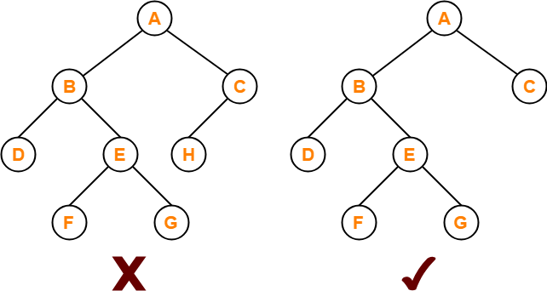
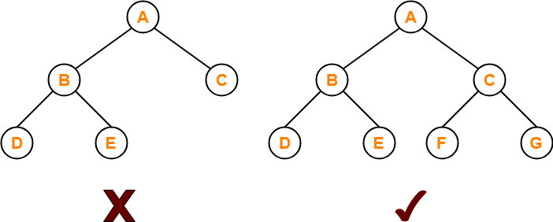
Full/ Strict Binary Tree
Complete/Perfect Binary Tree

Slide 14
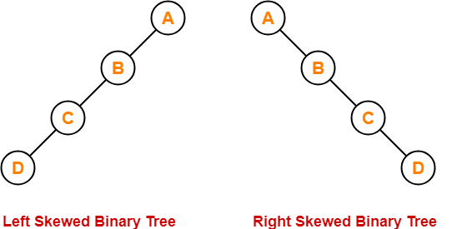
Skewed Binary Tree

Slide 15
Representation of Trees in memory
Linked representation
Array representation

Slide 16
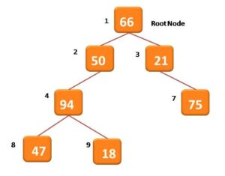
Array Representation of Tree
To store binary tree in a linear array, you need to consider the positional indexes of the nodes. This indexing must be considered starting with 1 from the root node going from left to right as you go down from one level to other.

Slide 17
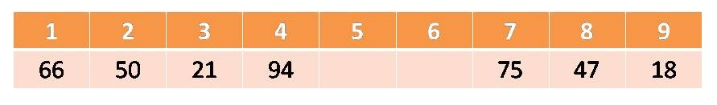
Array Representation of Tree T
The root N of T is stored in TREE [1].
If a node occupies TREE [k] then its left child is stored in TREE [2 * k] and its right child is stored into TREE [2 * k + 1]

Slide 18
Drawback??
If a binary tree contains less number of elements , is deep in structure, the memory underutilization is a major issue.

Slide 19

Linked List Representation of Tree
We use a double linked list to represent a binary tree. In a double linked list, every node consists of three fields. First field for storing left child address, second for storing actual data and third for storing right child address.

Slide 20
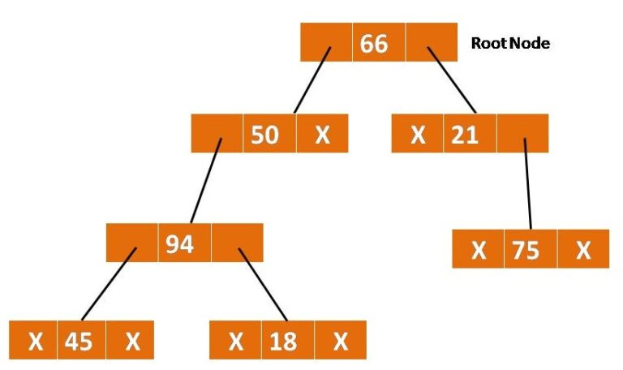
Linked List Representation of Tree

Slide 21
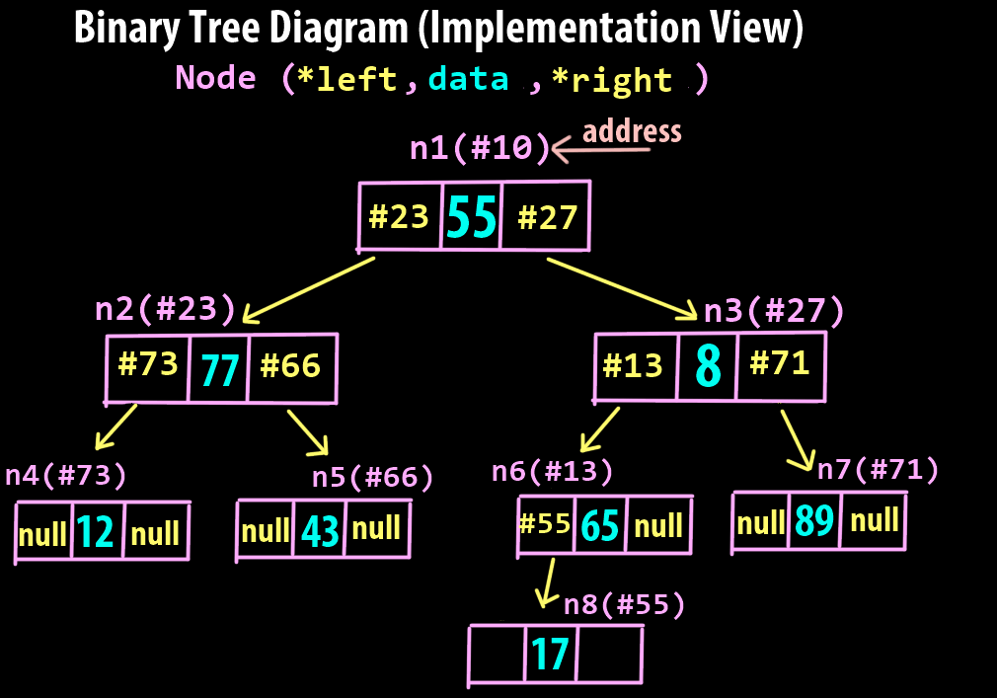
Continue..

Slide 22
Binary Tree Traversals
How to traverse a tree or visit each node in the tree exactly once?
Pre-Order Traversal
In-order Traversal
Post-Order Traversal

Slide 23
Algorithm Inorder(tree) 1. Traverse the left subtree, i.e., call Inorder(left-subtree) 2. Visit the root. 3. Traverse the right subtree, i.e., call Inorder(right-subtree)
IN ORDER TRAVERSAL
Algorithm Inorder(tree)
1. Traverse the left subtree, i.e., call Inorder(left-subtree)
2. Visit the root.
3. Traverse the right subtree, i.e., call Inorder(right-subtree)
PRE ORDER TRAVERSAL
Visit root node
Visit all the nodes in the left subtree
Visit all the nodes in the right subtree

Slide 24
POST ORDER TRAVERSAL
Visit all the nodes in the left subtree
Visit all the nodes in the right subtree
Visit the root node

Slide 25
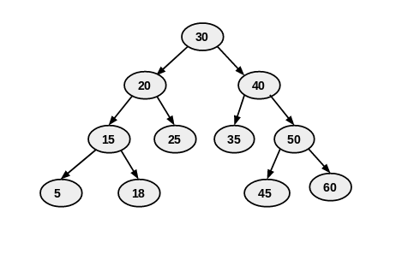
INORDER: 5,15,18,20,25,30,35,40,45,50,60
PREORDER:30,20,15,5,18,25,40,35,50,45,60
POSTORDER:5,18,15,25,20,35,45,60,50,40,30

Slide 26
Algorithm: Preorder traversal using stacks
Preorder Traversal: PREORD(INFO, LEFT, RIGHT, ROOT) : A binary tree T is in memory. The algorithm does a preorder traversal of T, applying an operation PROCESS to each of its nodes. An array STACK is used to temporarily hold the addresses of nodes.
[initially push NULL onto STACK & initialize PTR]
Set TOP=1, Stack[1]=NULL & PTR=ROOT
Repeat steps 3 to 5 while PTR≠NULL :
3. Apply PROCESS to INFO[PTR]
[Right Child?]
If RIGHT[PTR]≠NULL, then: [push on stack]
Set TOP=TOP+1 and
STACK[TOP]=RIGHT[PTR]
[End of if structure]
[Left child?]
If LEFT[PTR] ≠ NULL, then:
Set PTR=LEFT[PTR]
Else: [POP from stack]
Set PTR=STACK[TOP] & TOP=TOP-1
[End of If structure]
[End of step2 loop]
6. Exit

Slide 27
Algorithm: Inorder traversal using stacks
Inorder Traversal: INORD(INFO, LEFT, RIGHT, ROOT) : A binary tree T is in memory. The algorithm does a inorder traversal of T, applying an operation PROCESS to each of its nodes. An array STACK is used to temporarily hold the addresses of nodes.
[initially push NULL onto STACK & initialize PTR]
Set TOP=1, Stack[1]=NULL & PTR=ROOT
Repeat while PTR≠NULL : [pushes left most path onto STACK]
(a) Set TOP=TOP+1 & STACK[TOP]=PTR [saves node]
(b) Set PTR=LEFT[PTR] [updates PTR]
[End of loop]
Set PTR = STACK[TOP] & TOP=TOP-1 [Pops node from STACK]
Repeat steps 5 to 7 while PTR≠NULL: [Backtracking]
5. Apply PROCESS to INFO[PTR]
6. [Right Child?] If RIGHT[PTR]≠NULL, then:
(a) Set PTR = RIGHT[PTR]
(b) Go to step 2
[End of if structure]
Set PTR = STACK[TOP] & TOP=TOP-1 [Pops node]
[End of step 4 loop]
8. Exit

Slide 28
Algorithm: Postorder traversal using stacks
Postorder Traversal: POSTORD(INFO, LEFT, RIGHT, ROOT) : A binary tree T is in memory. The algorithm does a postorder traversal of T, applying an operation PROCESS to each of its nodes. An array STACK is used to temporarily hold the addresses of nodes.
[initially push NULL onto STACK & initialize PTR]
Set TOP=1, Stack[1]=NULL & PTR=ROOT
[push left-most path onto Stack]
Repeat steps 3 to 5 while PTR≠NULL:
Set TOP=Top+1 & STACK[TOP]=PTR
[Pushes PTR on STACK]
If RIGHT[PTR] ≠ NULL , then : [push on stack]
Set TOP=TOP+1 & STACK[TOP] = -RIGHT[PTR]
[End of if structure]
Set PTR = LEFT[PTR] [updates pointer PTR]
[End of step 2 loop]
Set PTR = STACK[TOP] & TOP=TOP-1
[pops node from Stack]
Repeat while PTR>0:
(a) Apply PROCESS to INFO[PTR]
(b) Set PTR = STACK[TOP] & TOP=TOP-1
[pops node from STACK]
[end of loop]
If PTR<0, then:
(a) Set PTR=-PTR
(b) Goto step2.
[End of if structure]
9. Exit

Slide 29
Question?

Slide 30
Books Recommended
Goodrich, Michael T., Tamassia, Roberto, and Mount, David M., “Data Structures and Algorithms in C++”, Wiley Student Edition.
Aho, Alfred V., Ullman, Jeffrey D., Hopcroft ,John E. “Data Structures and Algorithms”, Addison Wesley
Lipschutz, Seymour, “Data Structures”, Schaum's Outline Series, Tata McGraw Hill.
Gilberg/Forouzan,” Data Structure with C ,Cengage Learning.
Augenstein,Moshe J , Tanenbaum, Aaron M, “Data Structures using C and C++”, Prentice Hall of India

